Slide 1
OTT Content Analysis Dashboard

Slide 2
Project Introduction
Analyze OTT content catalog to identify content trends, genre performance, country contribution, rating strategy, and portfolio balance.

Slide 3
Business Objectives
• Understand content catalog
• Analyze growth trends
• Evaluate genres
• Assess content portfolio
• Support strategic decisions

Slide 4
Dataset Overview
Dataset includes Title, Type, Director, Cast, Country, Date Added, Release Year, Rating, Duration, and Genres.

Slide 5
Tools & Techniques Used
Excel, Pivot Tables, Pivot Charts, Slicers, Dashboard Design, Data Cleaning, Conditional Formatting.

Slide 6
Data Preparation
• Missing Value Analysis
• Duplicate Detection
• Date Standardization
• Duration Separation
• Summary Metrics Creation

Slide 7
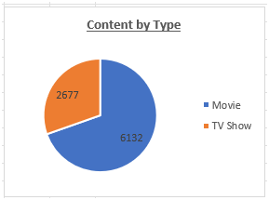
Content Distribution Analysis

Slide 8
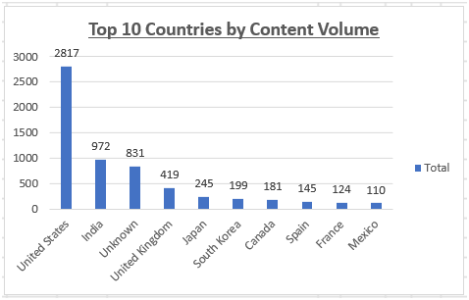
Country Analysis

Slide 9
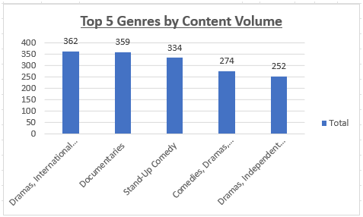
Genre Analysis

Slide 10
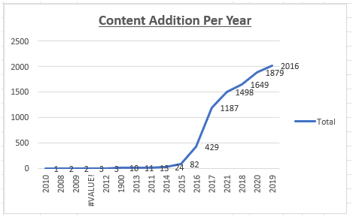
Content Growth Analysis

Slide 11
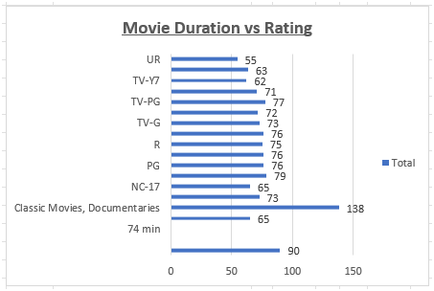
Rating & Duration Analysis

Slide 12
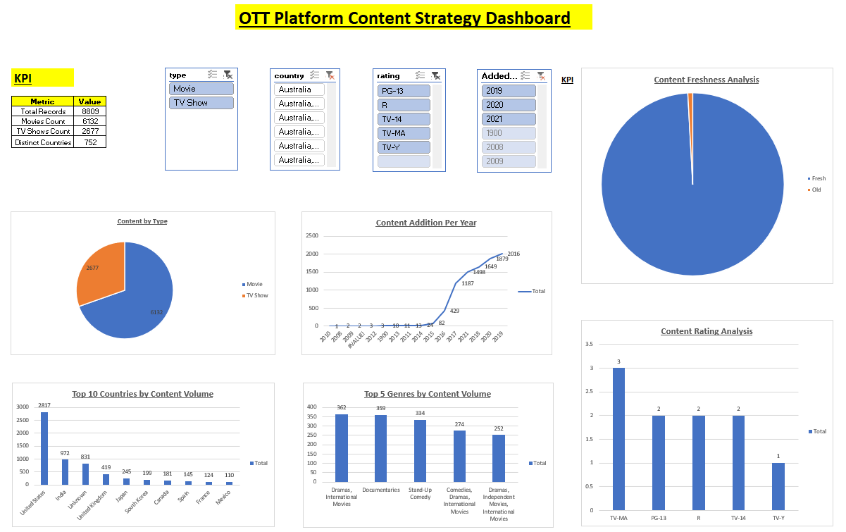
Dashboard Overview

Slide 13
Key Business Insights
• Strong content growth
• Drama & International genres dominate
• Country concentration exists
• Fresh content strategy
• Strong TV show engagement

Slide 14
Executive Summary
Strengths, Risks, and Strategic Recommendations based on data-driven insights.

Slide 15
Skills Demonstrated & Conclusion
Data Cleaning, Pivot Tables, Dashboarding, KPI Reporting, Business Analytics, Data Visualization.

